Slide 1

🎹 Spotify Tracks Dataset
Machine Learning
Author: Giulia Sonsino (4647227)

Slide 2

Importing Libraries and Loading Dataset
https://www.kaggle.com/datasets/maharshipandya/-spotify-tracks-dataset/data
Dataset with :
114000 rows → each row is a song with some features
20 features

Slide 3
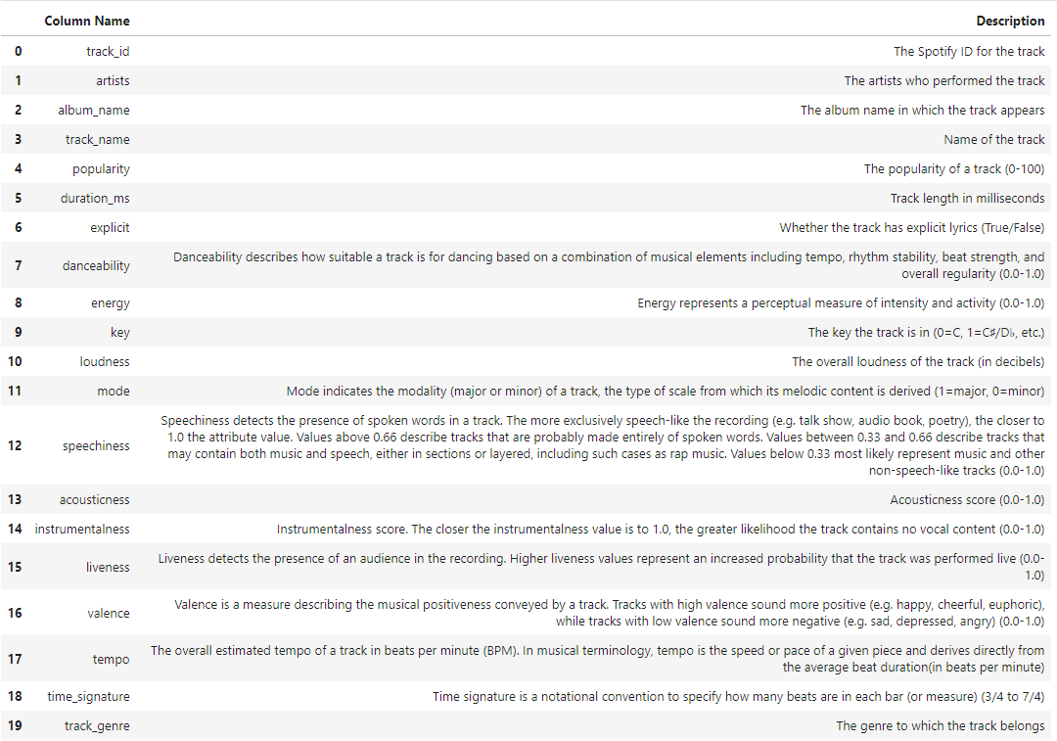

Slide 4
Data Cleaning
Checking for missing values and remove rows with missing values
Feature Engineering
Removing duplicate tracks (same track name and artists)
Outliers detection

Slide 5
Feature Engineering
Binary Encoding for ‘explicit’ feature: true → 1, false → 0
Label Encoding for ‘genre’ feature: LabelEncoder to transform a column of categorical values into integer labels. It assigns the same number to all instances with the same category name

Slide 6
Outliers Detection
IQR (Interquantile Range): a measure used to identify outliers. It’s commonly used to detect outliers because it captures the central tendency of data (while ignoring the extreme values)
Finding outliers regarding tracks’ duration…

Slide 7
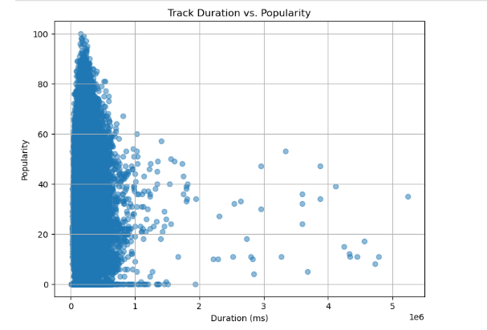
Outliers detection (duration)
Visual Inspection for Potential Outliers: Duration vs. Popularity

Slide 8
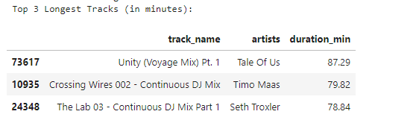
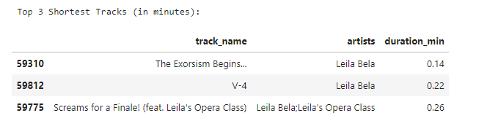
Outliers detection (duration of tracks)
3 Longest Tracks before removing outliers
3 Shortest Tracks before removing outliers

Slide 9
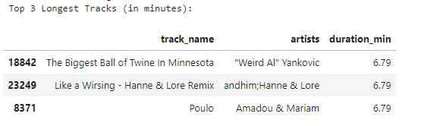
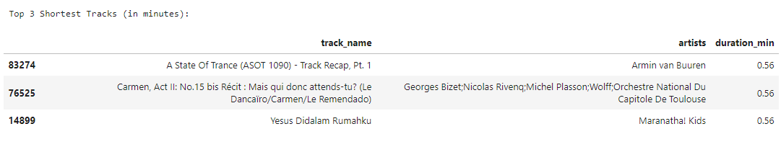
After Removing Outliers (duration)
3 Longest Tracks
3 Shortest Tracks

Slide 10

Data Analysis
Top 10 Most Popular Genres (Average Popularity)
Artists with the Highest Number of Tracks
Top 15 Artists with the Highest Average Popularity

Slide 11
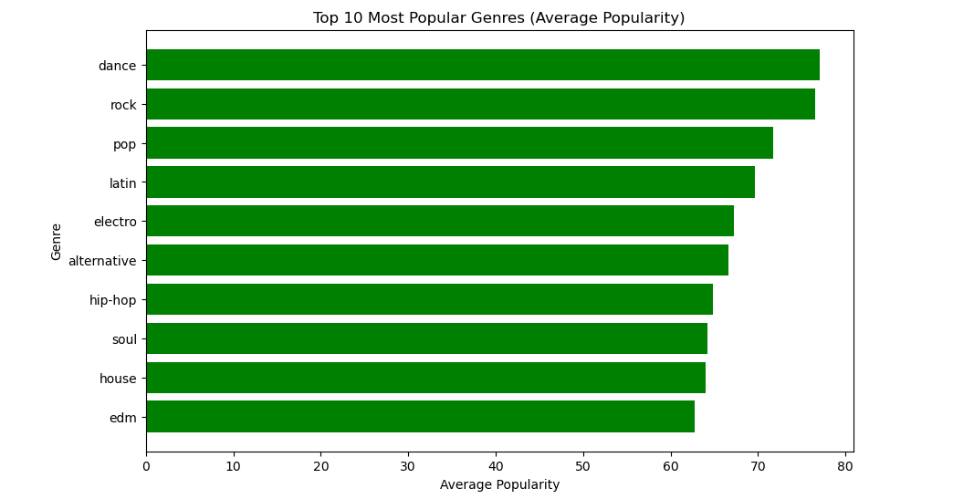
Top 10 Most Popular Genres

Slide 12
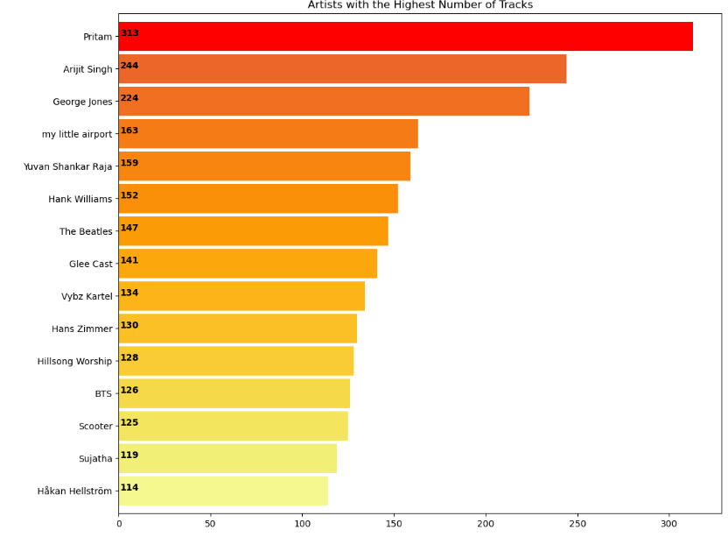
Artists with the Highest Number of Tracks

Slide 13
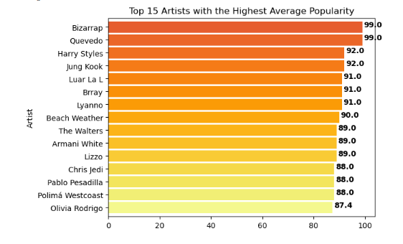
Top 15 Artists with the Highest Average Popularity

Slide 14
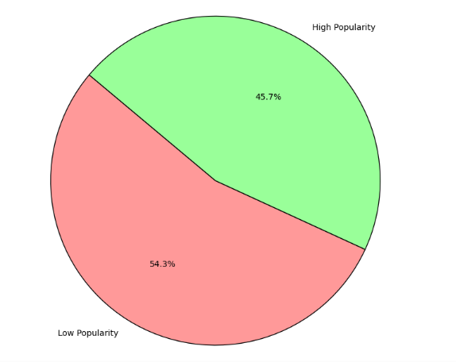
Popularity Prediction
Distribution of popularity
(popular tracks vs non-popular tracks)
Popular tracks: popularity >= 40

Slide 15

Models
Metrics:
Accuracy: measures the proportion of correctly predicted instances
ROC AUC (Receiver Operating Characteristic - Area Under Curve): measures the model’s ability to distinguish between the classes
F1 Score
Recall: measures the proportion of actual positives correctly identified.
Logistic Regression
K-Nearest Neighbors(KNN)
Random Forest Classifier

Slide 16
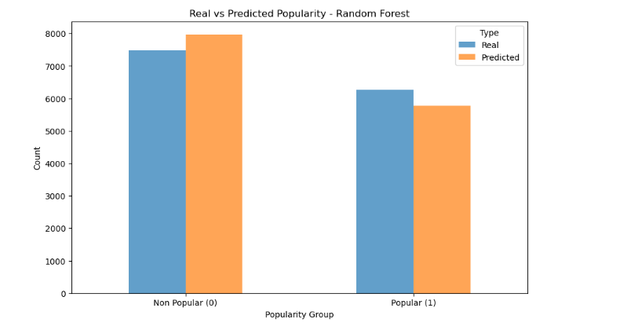

Slide 17
Hyperparameter Tuning
Process of finding the best set of hyperparameters for a machine learning model to optimize its performance.
I used this process with Random Forest:
'n_estimators': [100, 200, 300], 'max_depth': [None, 10, 20, 30], 'min_samples_split': [2, 5, 10], 'min_samples_leaf': [1, 2, 4]

Slide 18
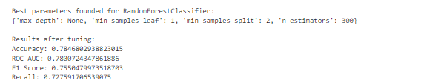
These results suggest that the Random Forest classifier, with the optimized hyperparameters, performs well in predicting whether a track is popular based on its features

Slide 19
Recommendations System
I wrote a function that:
Takes in input a song name (checks if a song with this name exists in the dataset) and a number of recommendations ‘n’;
Calculates the similarity scores between the features of the input song and all the other songs in the dataset;
Identifies the ‘n’ most similar songs and returns tracks names, artists, album names, popularity and genre.
danceability', 'energy', 'key', 'loudness', 'mode','acousticness', 'liveness', 'valence', 'tempo', 'genre_encoded', 'artists_encoded', 'popularity'

Slide 20
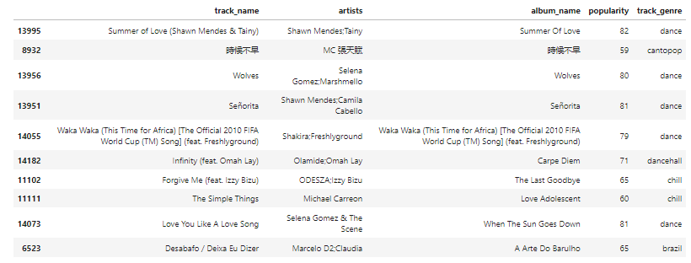
Recommended songs for ‘There's Nothing Holdin' Me Back’ by Shawn Mendes

Slide 21
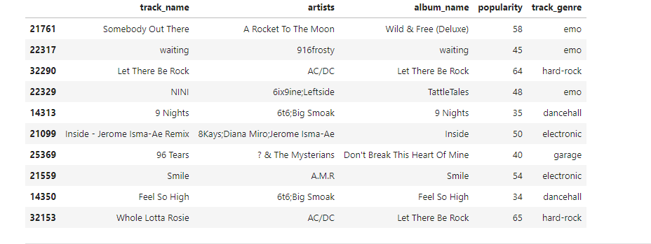
Recommended songs for ‘Back in Black' Me Back’ by AC/DC

Slide 22
Thanks!

